Slide 1
Introduction to Machine Learning
Soumya Banerjee

Slide 2
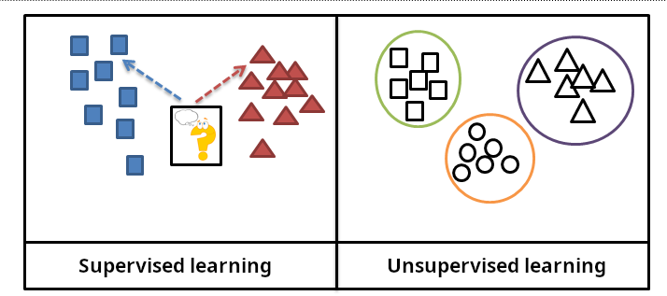
Types of Machine Learning
Slide courtesy Paul Fannon

Slide 3
Supervised Learning - Regression
Student | ML Trained? | Cohort %ile | Salary
0001 | Y | 12 | 120000
0002 | Y | 58 | 42000
0003 | N | 22 | 36000
0004 | Y | 58 | 35000
… | … | … | …
1784 | Y | 34 | ???
Slide courtesy Paul Fannon

Slide 4
Unsupervised methods
History
Exploratory data analysis
Hypothesis generation
Data visualization
Data imputation
Detecting outliers
Notes:
Slide on single-cell rna seq tsne xx
Slide on bulk seq data

Slide 5
High-dimensional data
How to visualize high-dimensional data
Pairwise

Slide 6

High-dimensional data
https://stats.stackexchange.com/questions/2691/making-sense-of-principal-component-analysis-eigenvectors-eigenvalues

Slide 7


Interactive tool
https://projector.tensorflow.org/

Slide 8
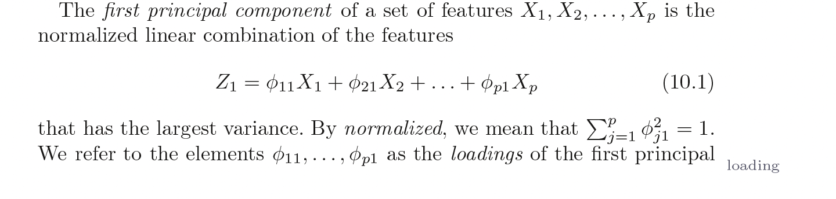
PCA
Introduction to Statistical Learning in R

Slide 9
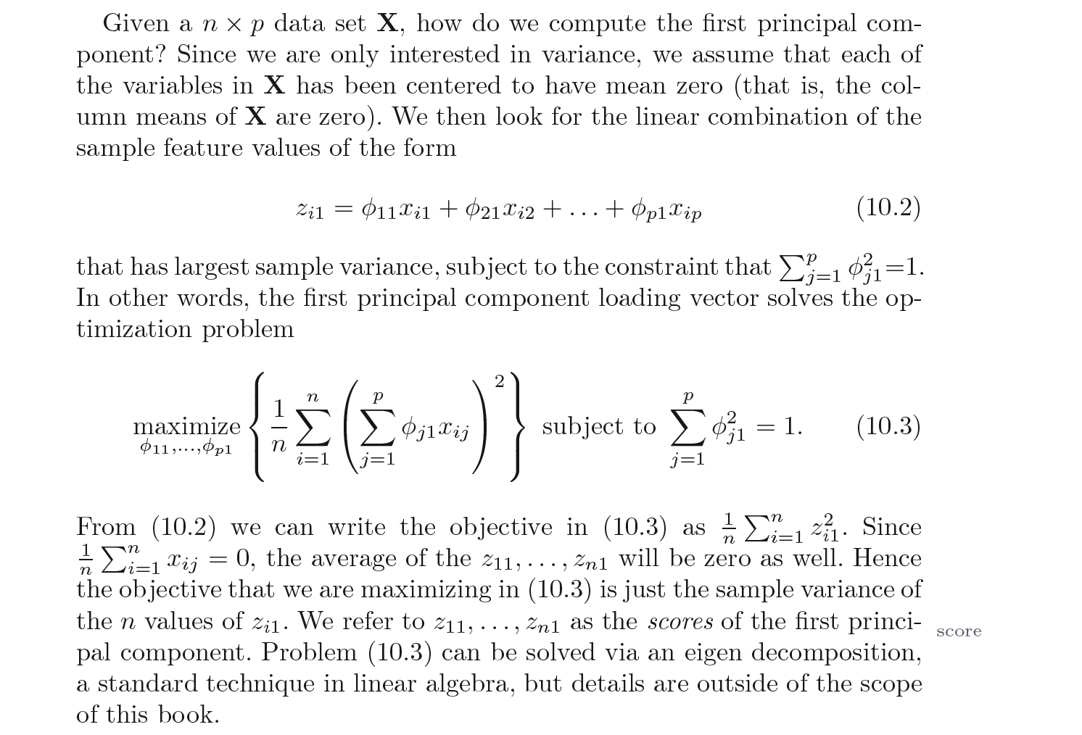
PCA
Introduction to Statistical Learning in R

Slide 10
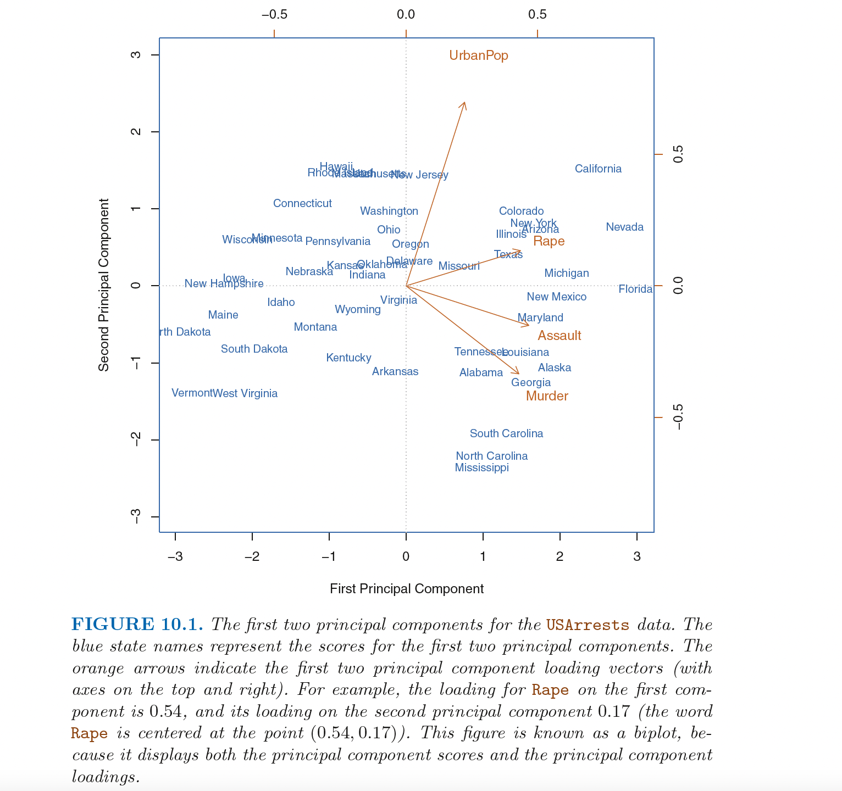

Slide 11
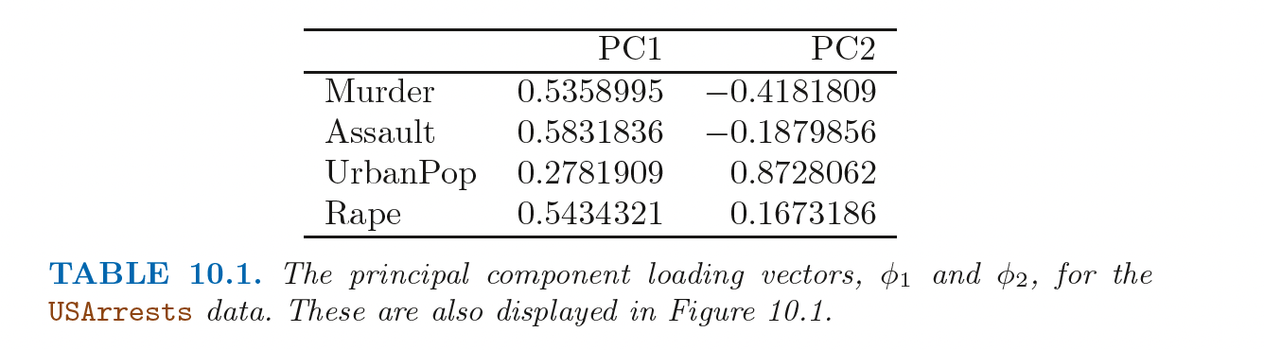
PCA
Introduction to Statistical Learning in R

Slide 12
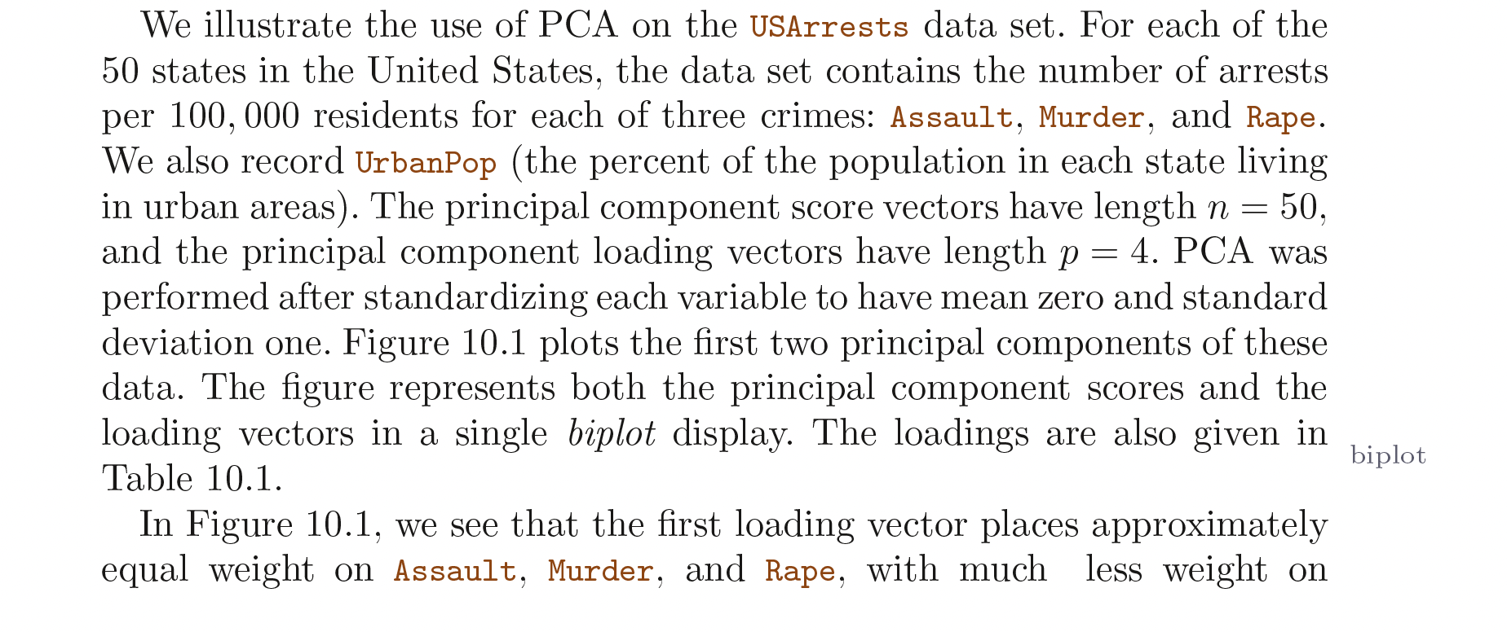
PCA
Introduction to Statistical Learning in R

Slide 13
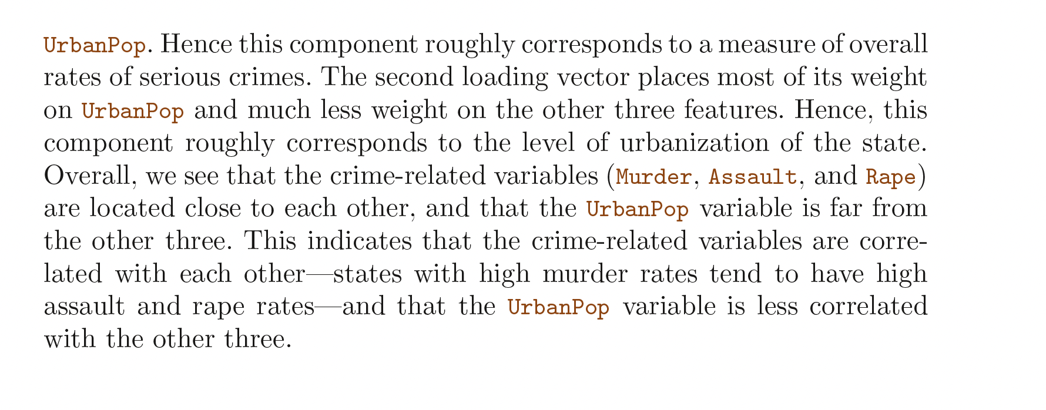
PCA
Introduction to Statistical Learning in R

Slide 14
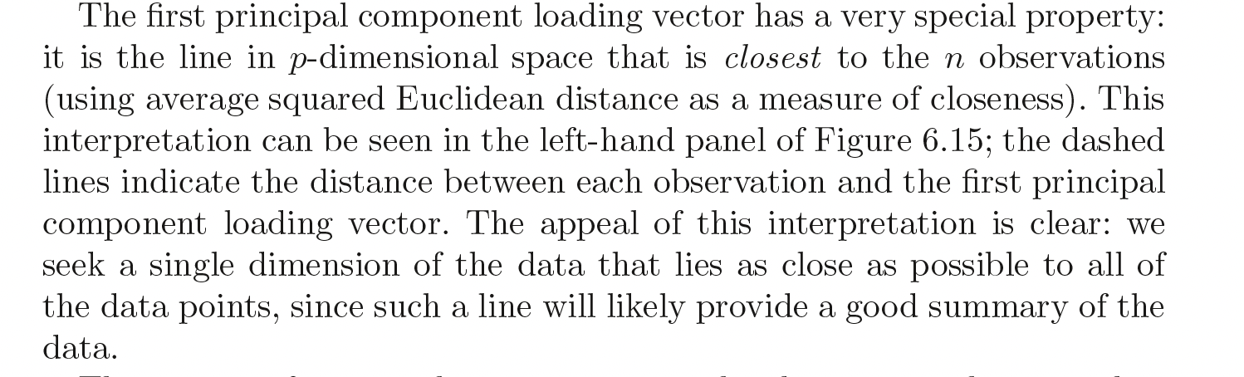
PCA
Introduction to Statistical Learning in R

Slide 15
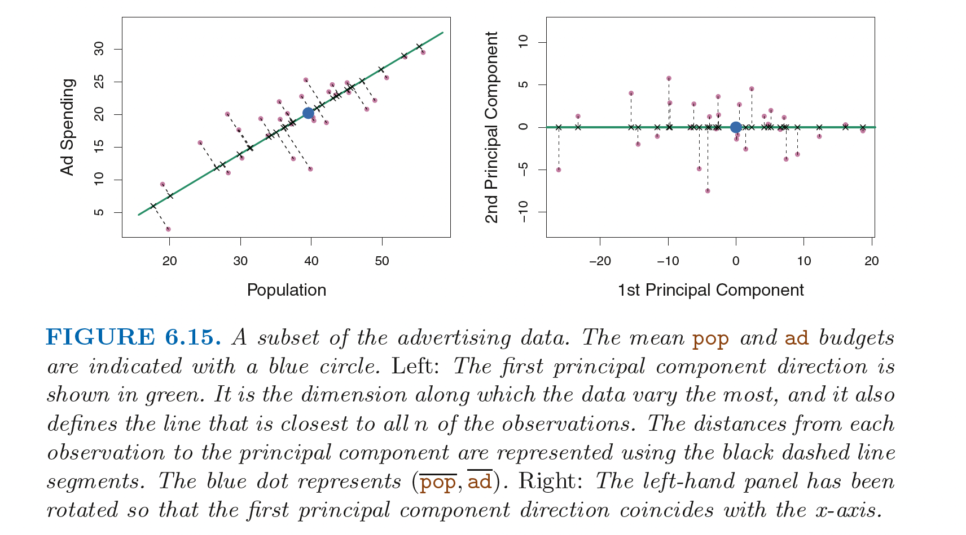
PCA
Introduction to Statistical Learning in R

Slide 16
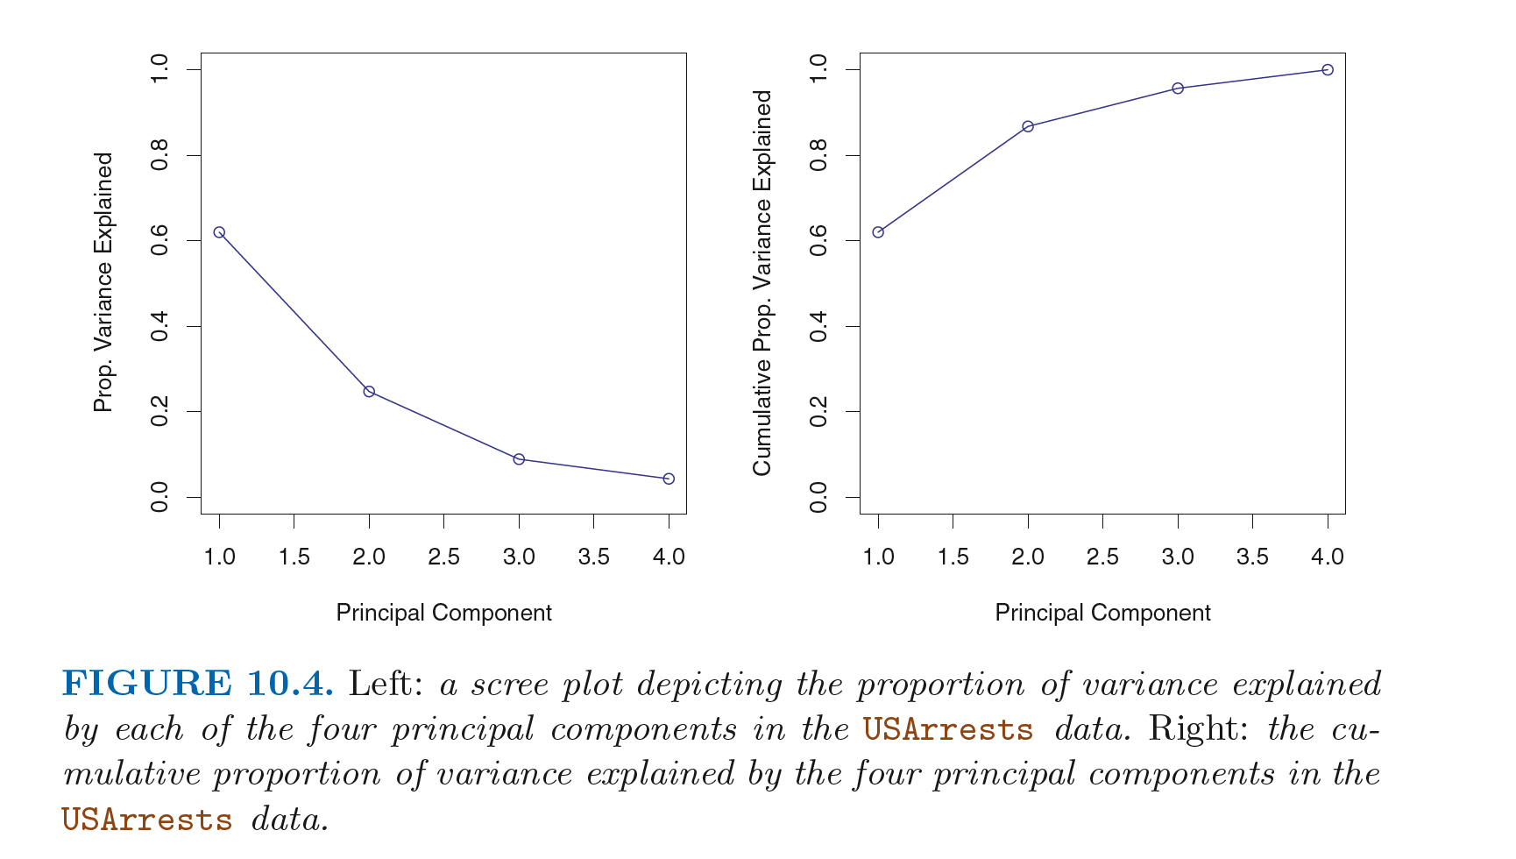
Scree plots (PRACTICAL)
Introduction to Statistical Learning in R

Slide 17
Non-linear
How to make a non-linear dimensionality reduction technique?

Slide 18

Important concept
Information bottleneck
Notes:
This is how you achieve word embedding

Slide 19
generalizations of this idea
tSNE
Autoencoder (non-linear loss function)

Slide 20
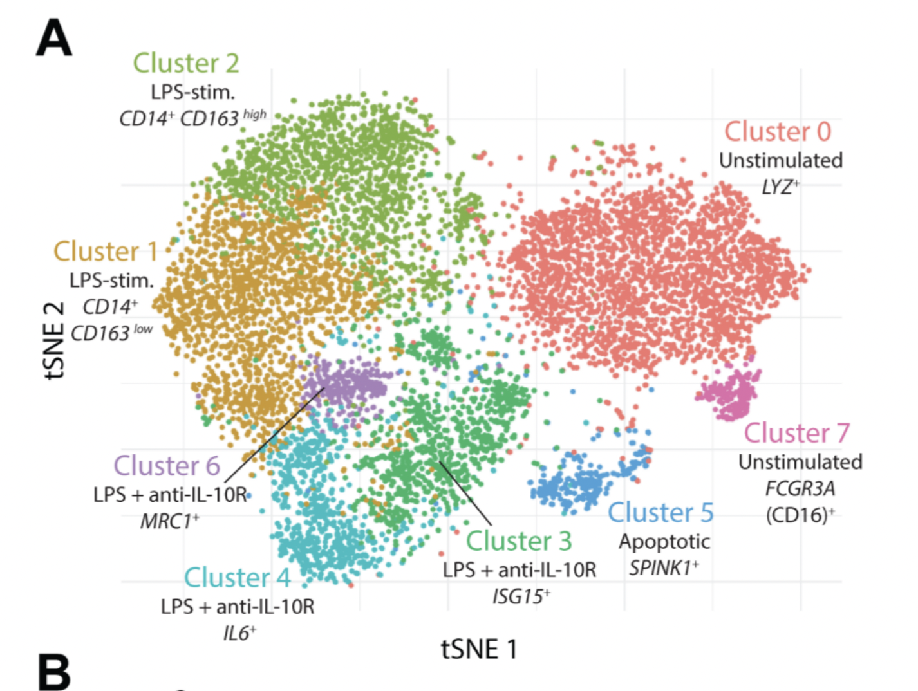
Case study
a. stochastic b. distances not preserved c. difficult to communicate to non-technical experts
Notes:
Example of IL10 project (tSNE and heatmaps from a bioinformatics project)

Slide 21
Visualizations can be misleading
1. distances not preserved in tsne
https://distill.pub/2016/misread-tsne/ 2. cluster sizes do not matter 3. you can see some shapes sometimes
4. random does not always look random
Notes:
Example of IL10 project (tSNE and heatmaps from a bioinformatics project)

Slide 22
1. problems with communicating high dimensional data 2. High dimensions are difficult to visualize
Visualizing high-dimensions
Notes:
Example of IL10 project (tSNE and heatmaps from a bioinformatics project)

Slide 23

Case study
Notes:
Example of IL10 project (tSNE and heatmaps from a bioinformatics project)

Slide 24

Case study
Notes:
Can anyone guess why this map is distorted?

Slide 25

Area proportional to number of vaccine doses
Notes:
Maps of the global distribution of seasonal influenza vaccine in the year 2013. Data for vaccine doses are from Palache et al. (2015). Region boundaries and population data are sourced directly from the R package rnaturalearthhires (South, 2020), which uses boundaries based on de facto status. We do not adopt a political stance on these boundaries. (a) Choropleth map based on the Hobo-Dyer equal-area projection. (b) Choropleth cartogram where countries are depicted with an area in proportion to the number of vaccine doses.

Slide 26
cartograms
https://go-cart.io/tutorial
Notes:
Can anyone guess why this map is distorted?

Slide 27
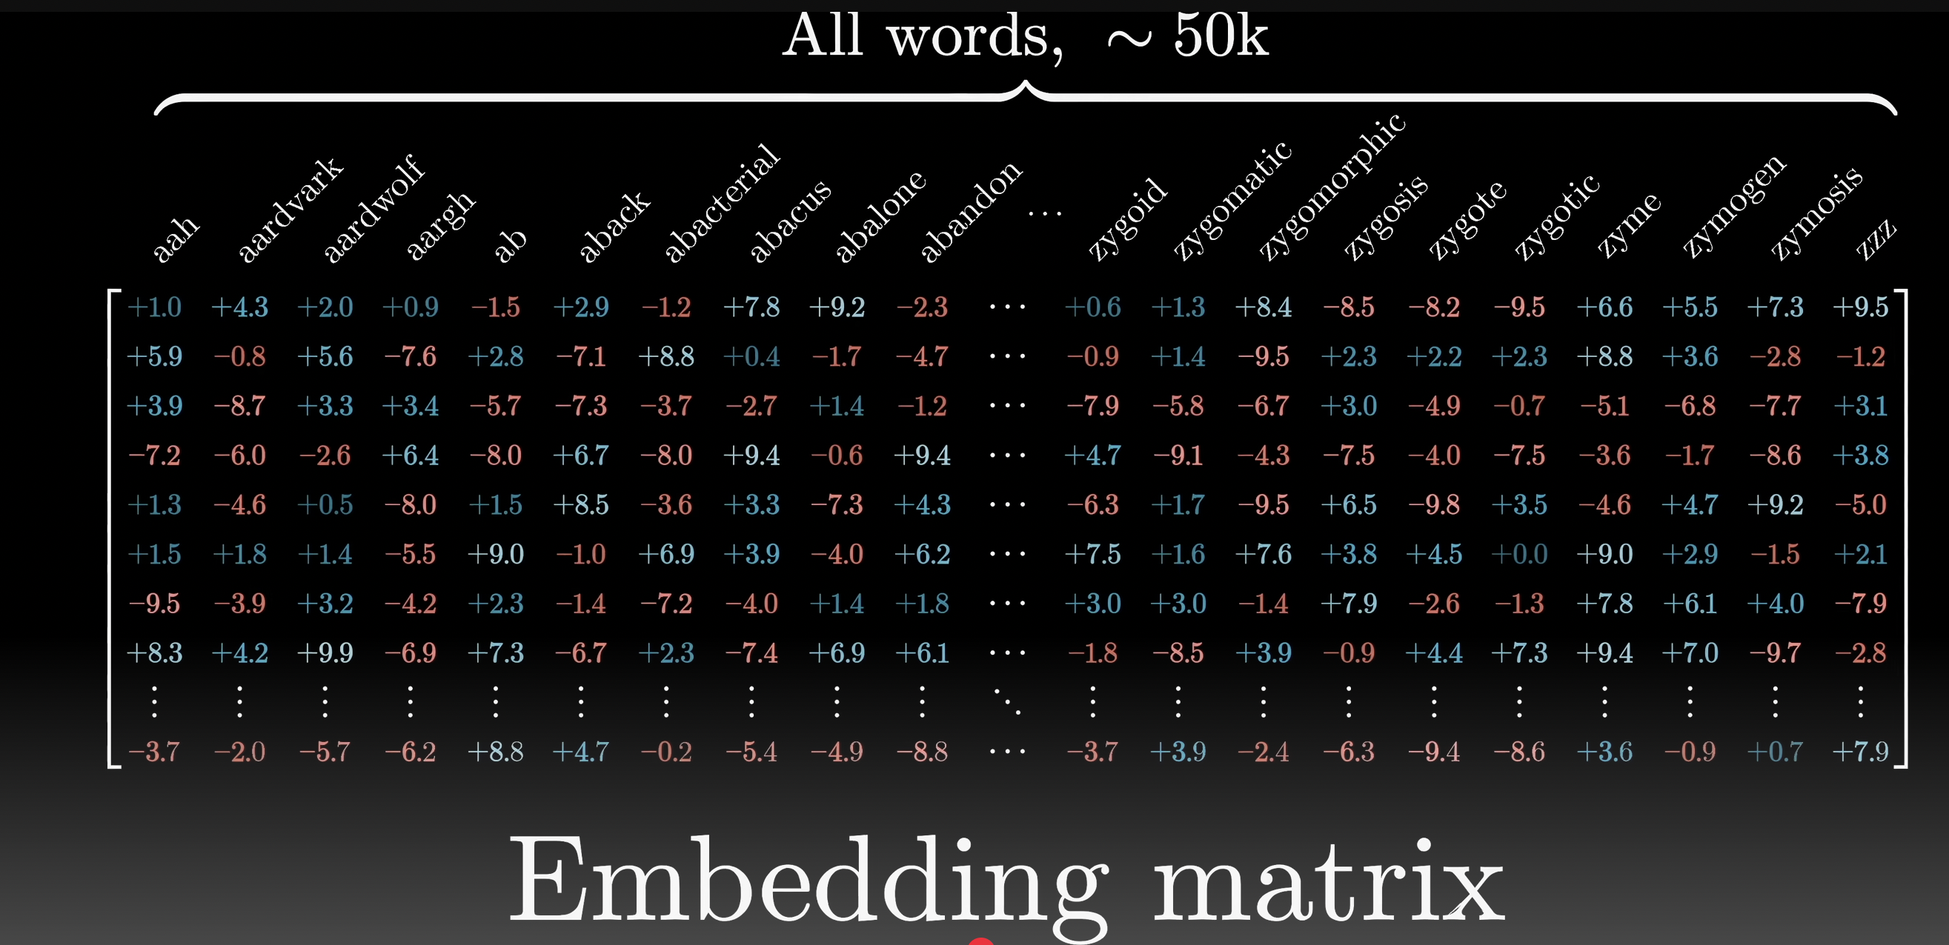
Applications to Large-Language Models
Video by 3blue1brown
Notes:
See autoencoder slide on how to achieve this

Slide 28
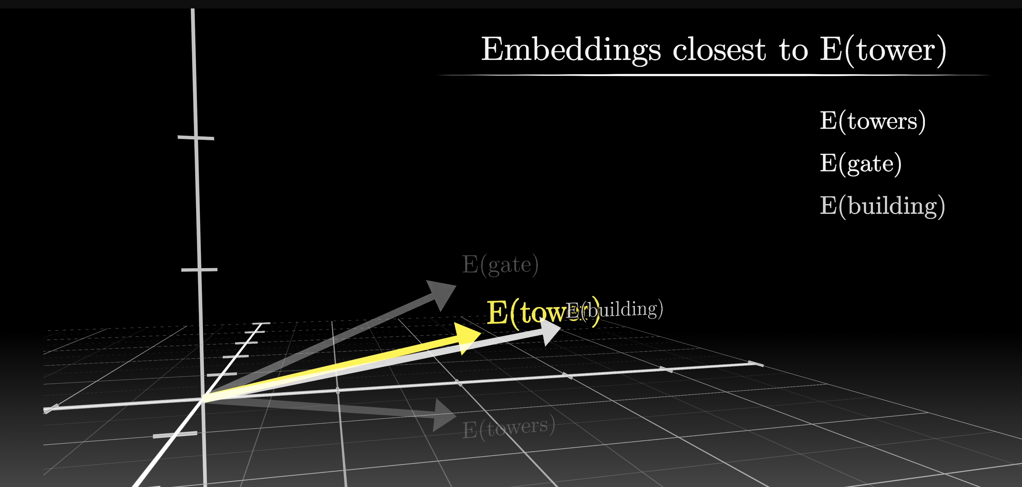
Applications to Large-Language Models
Video by 3blue1brown

Slide 29
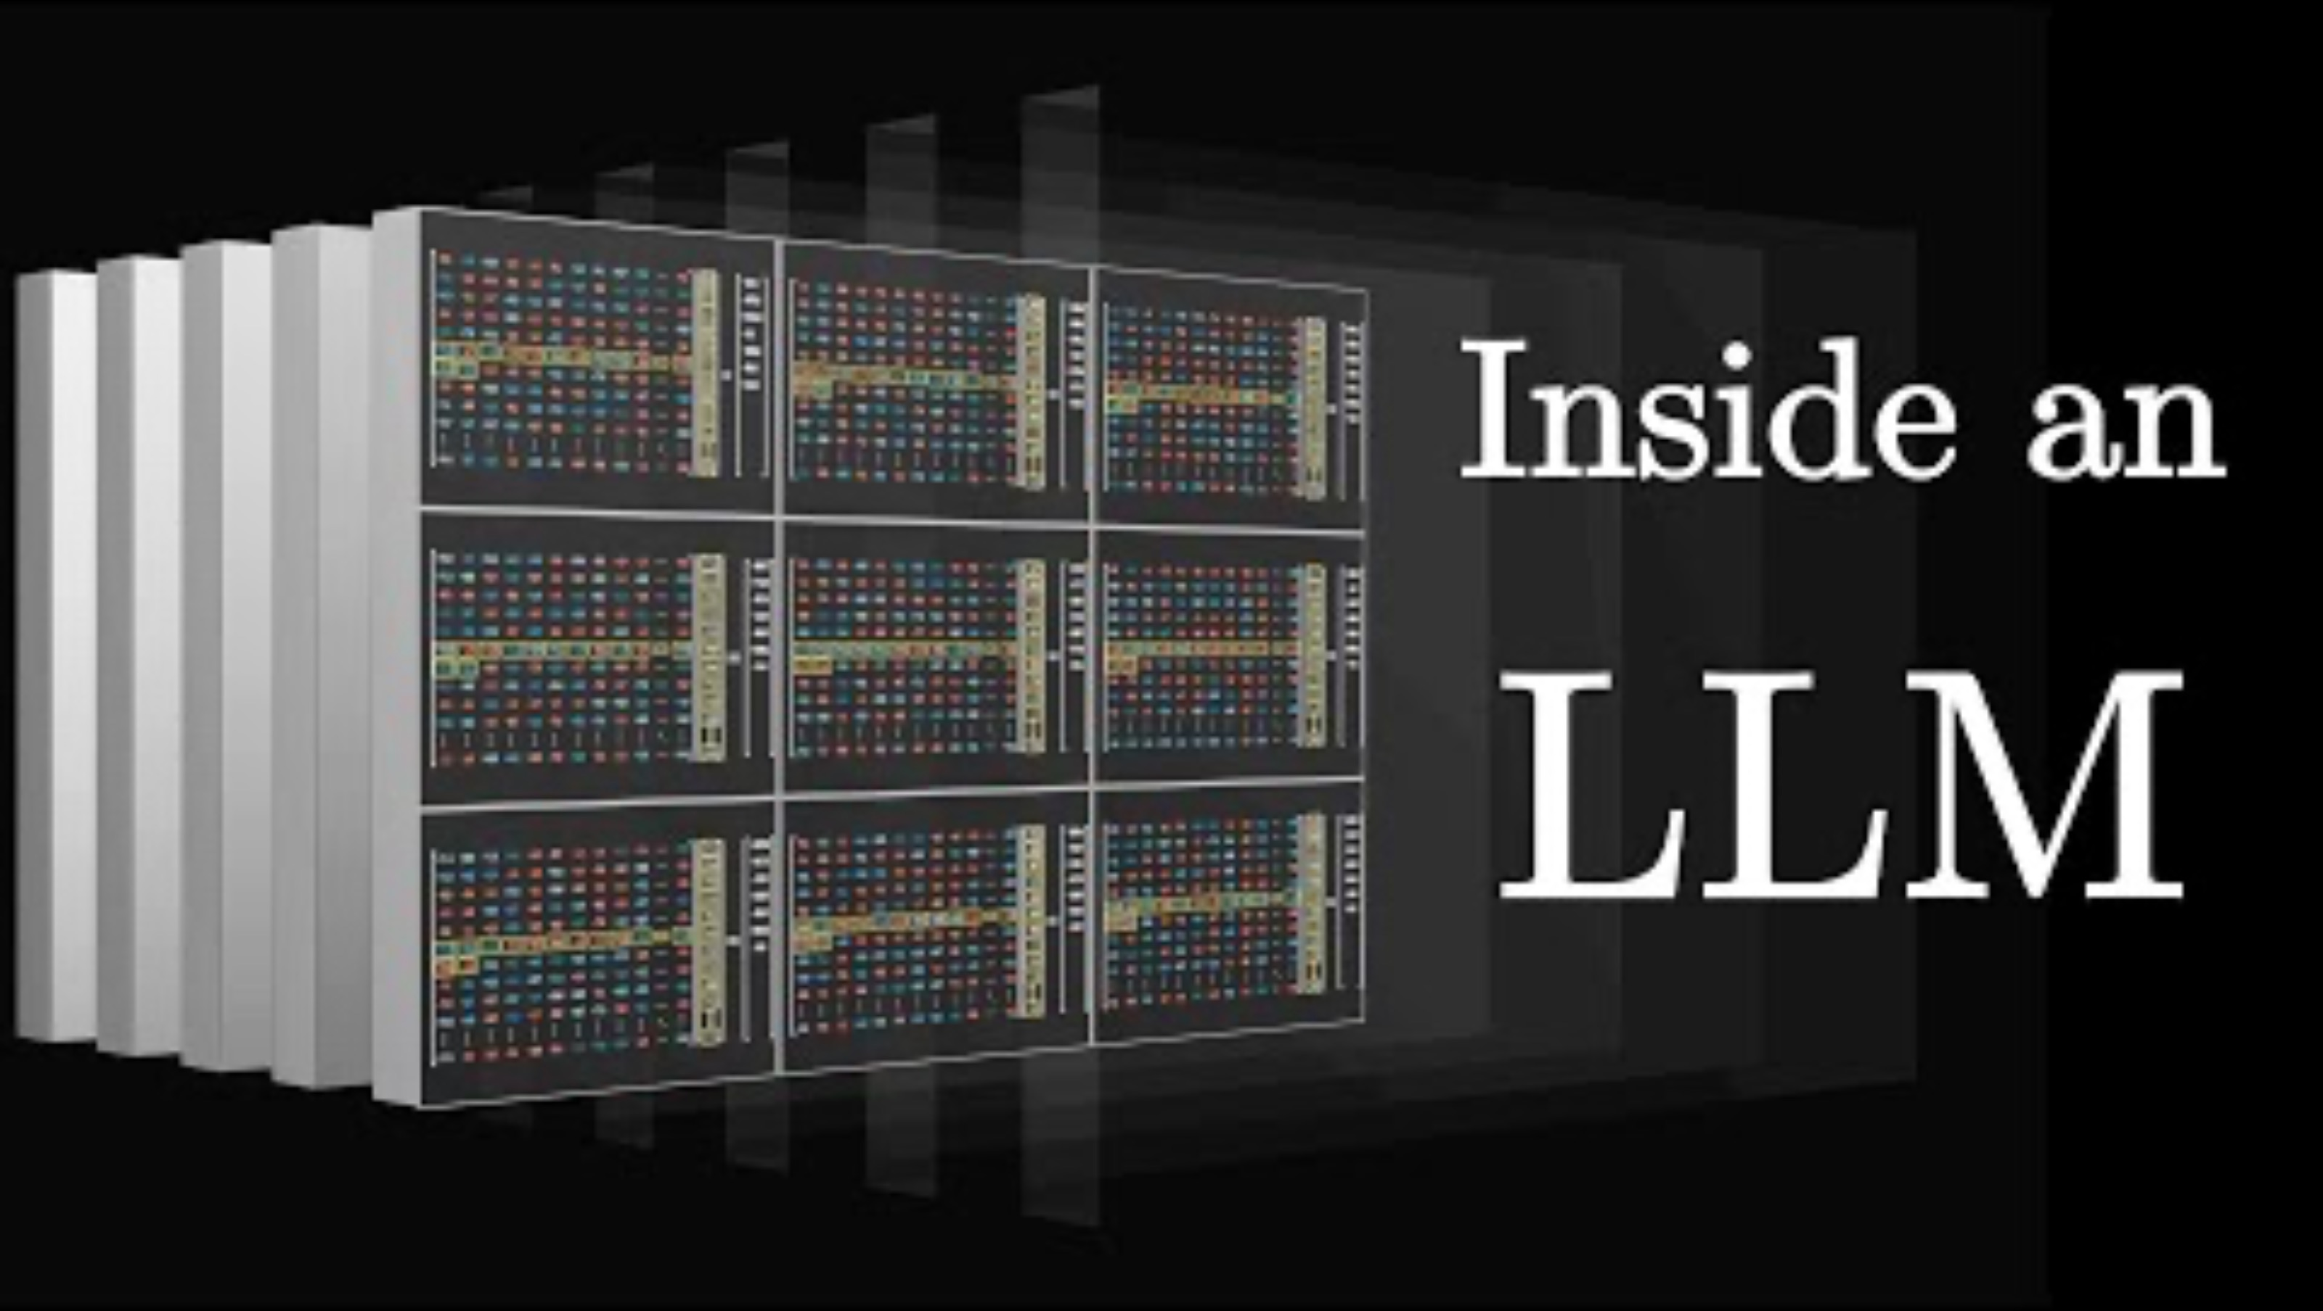
Applications to Large-Language Models
Video by 3blue1brown

Slide 30
K means Clustering

Slide 31
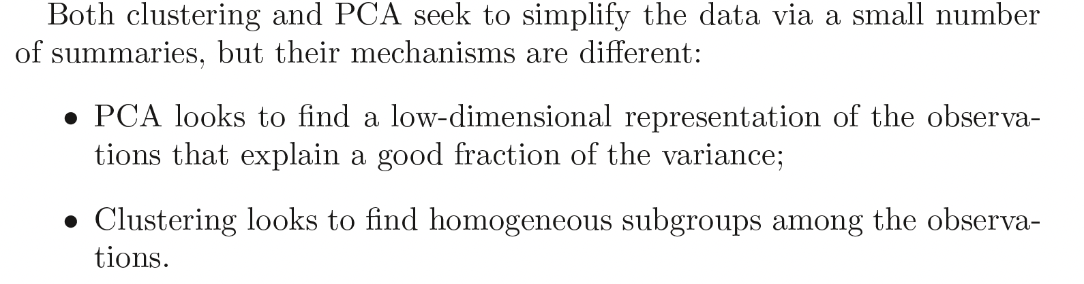
Clustering
Introduction to Statistical Learning in R

Slide 32
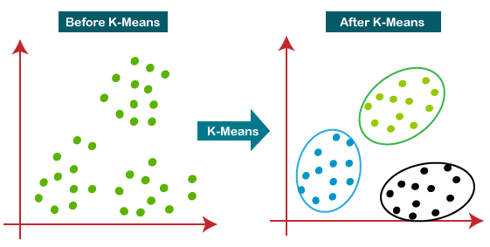
K-means Clustering

Slide 33
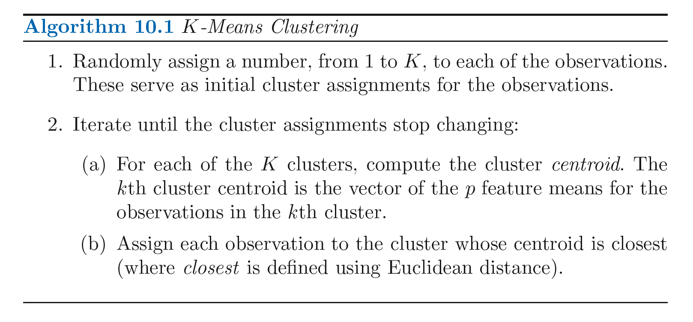
K-means Clustering
Introduction to Statistical Learning in R

Slide 34
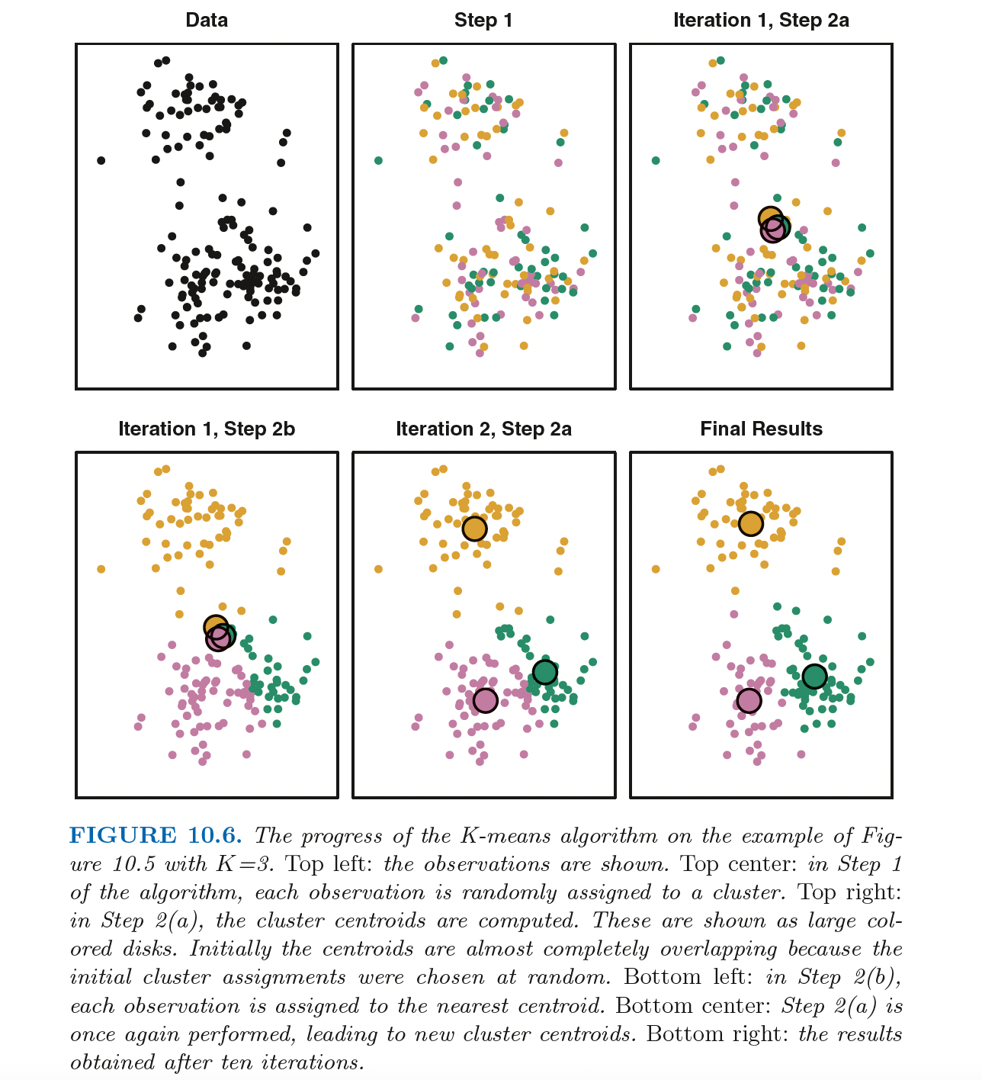

Slide 35
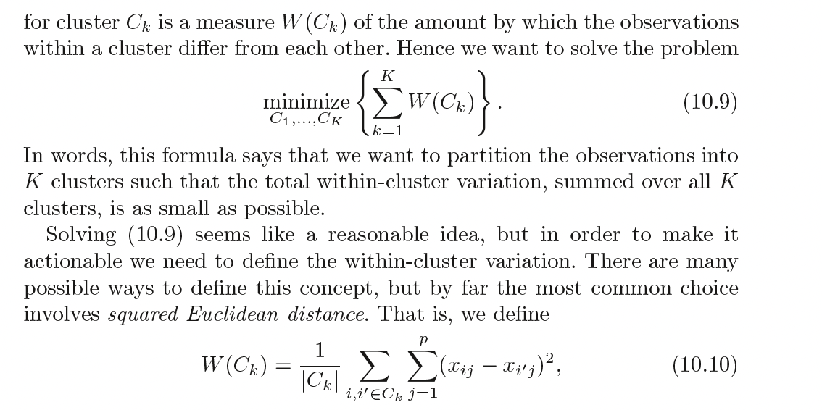
Introduction to Statistical Learning in R

Slide 36
K-means Clustering
1. Assign each data point to their closest centroid.
2. Work out the mean of each resulting cluster and make this the new centroid.
https://www.youtube.com/watch?v=5I3Ei69I40s&ab_channel=bitLectures
https://www.youtube.com/watch?v=R2e3Ls9H_fc

Slide 37
K-means Clustering
How to apply this to high-dimensional data (more than 2 variables/features)
How to visualize the result of k-means on this data?

Slide 38
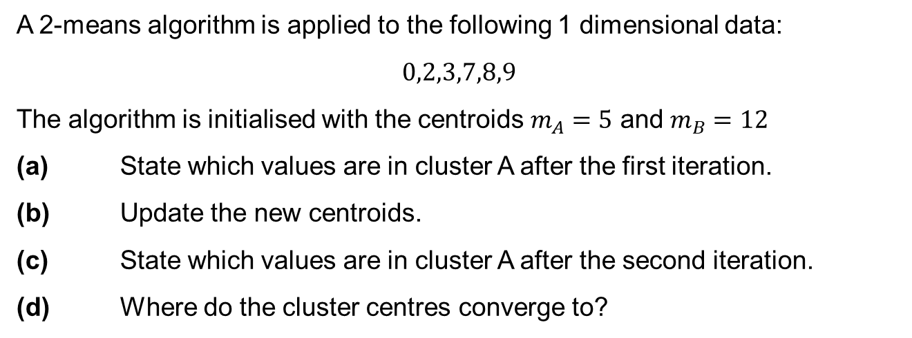
K means example
A 2-means algorithm is applied to the following 1 dimensional data:
$$0,2,3,7,8,9$$
The algorithm is initialised with the centroids $m_{A}=5$ and $m_{B}=12$
(a) State which values are in cluster A after the first iteration.
(b) Update the new centroids.
(c) State which values are in cluster A after the second iteration.
(d) Where do the cluster centres converge to?
Slide courtesy Paul Fannon

Slide 39
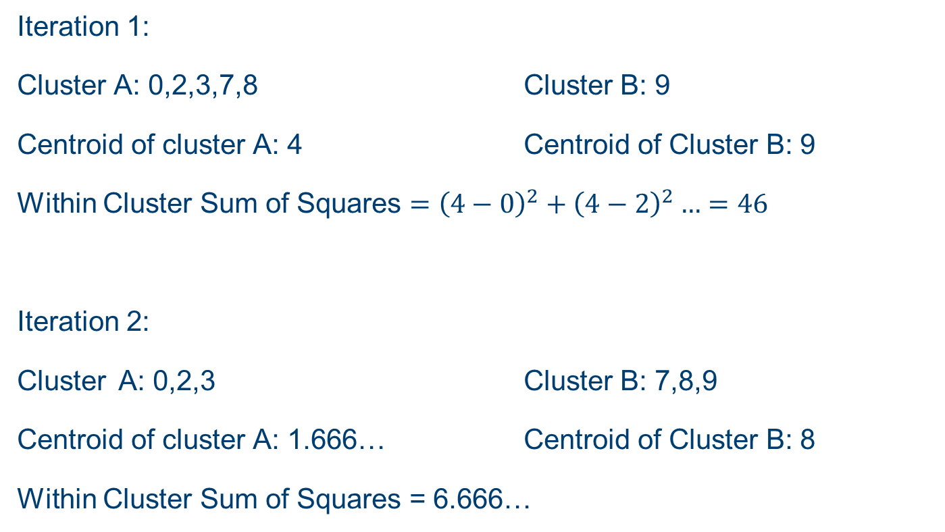
K means example
Iteration 1:
Cluster A: 0,2,3,7,8 Cluster B: 9
Centroid of cluster A: 4 Centroid of Cluster B: 9
Within Cluster Sum of Squares $={\left(4−0\right)}^{2}+{\left(4−2\right)}^{2}…=46$
Iteration 2:
Cluster A: 0,2,3 Cluster B: 7,8,9
Centroid of cluster A: 1.666… Centroid of Cluster B: 8
Within Cluster Sum of Squares = 6.666…
Slide courtesy Paul Fannon

Slide 40
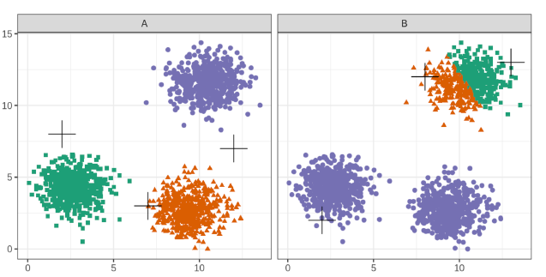
Choice of initial centroids
Slide courtesy Paul Fannon

Slide 41
Choosing k
Slide courtesy Paul Fannon

Slide 42
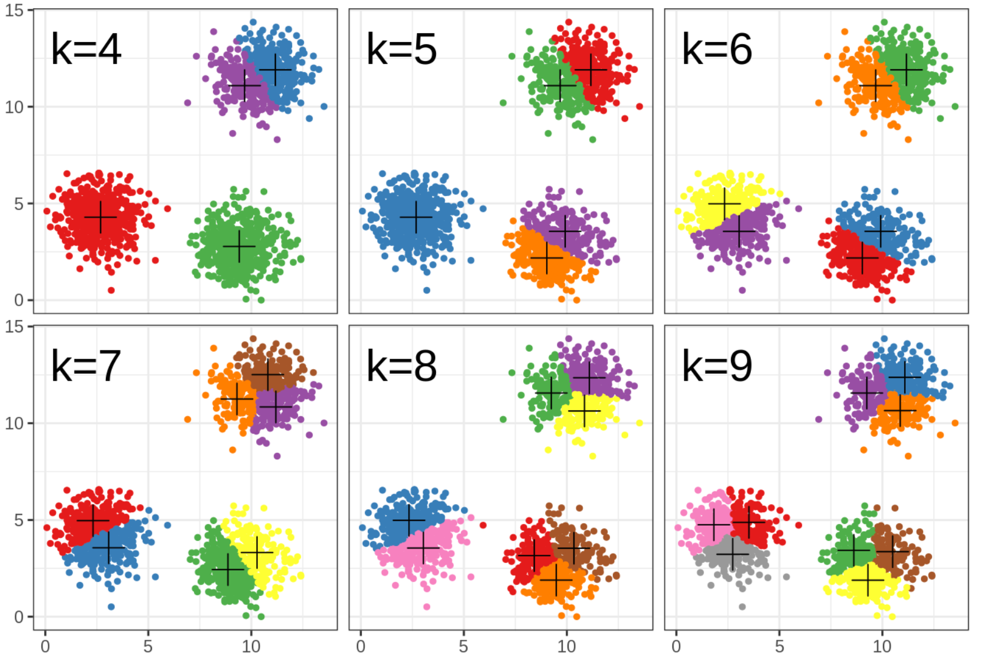
Choosing k
Slide courtesy Paul Fannon

Slide 43
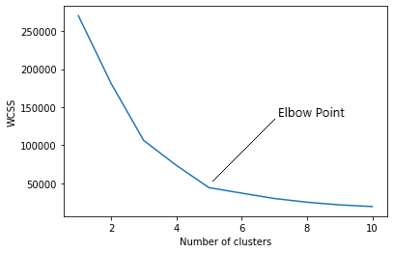
How to find the value of K
Slide courtesy Paul Fannon

Slide 44
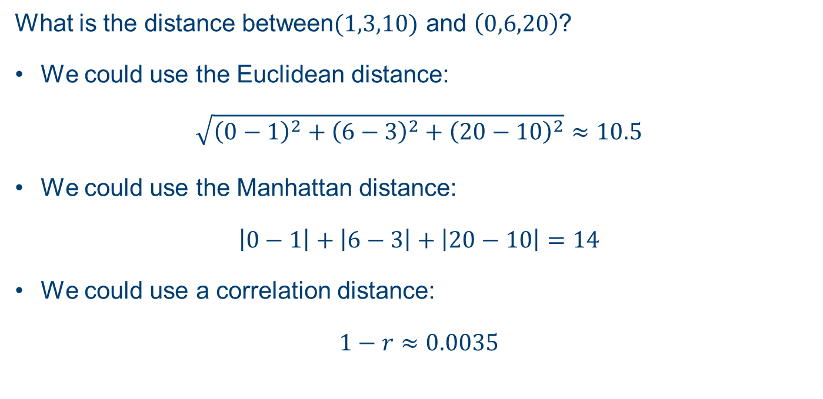
Clustering Distances
What is the distance between$(1,3,10)$ and $\left(0,6,20\right)$?
We could use the Euclidean distance:
$$\sqrt{{\left(0−1\right)}^{2}+{\left(6−3\right)}^{2}+{\left(20−10\right)}^{2}}≈10.5$$
We could use the Manhattan distance:
$$\left|0−1\right|+\left|6−3\right|+\left|20−10\right|=14$$
We could use a correlation distance:
$$1−r≈0.0035$$
Slide courtesy Paul Fannon

Slide 45
Hierarchical Clustering

Slide 46
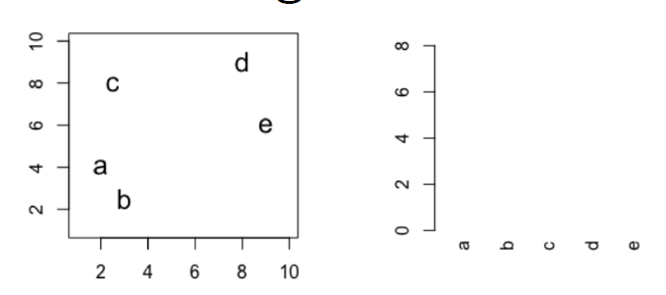
Hierarchical clustering
Slide courtesy Paul Fannon

Slide 47
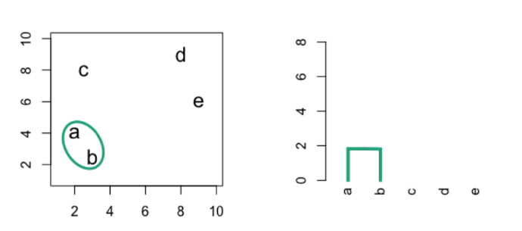
Hierarchical clustering
Slide courtesy Paul Fannon

Slide 48
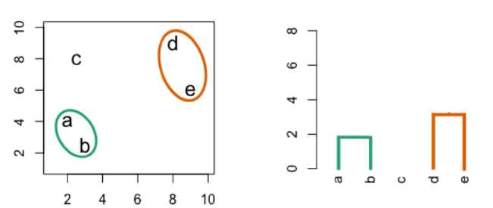
Hierarchical clustering
Slide courtesy Paul Fannon

Slide 49
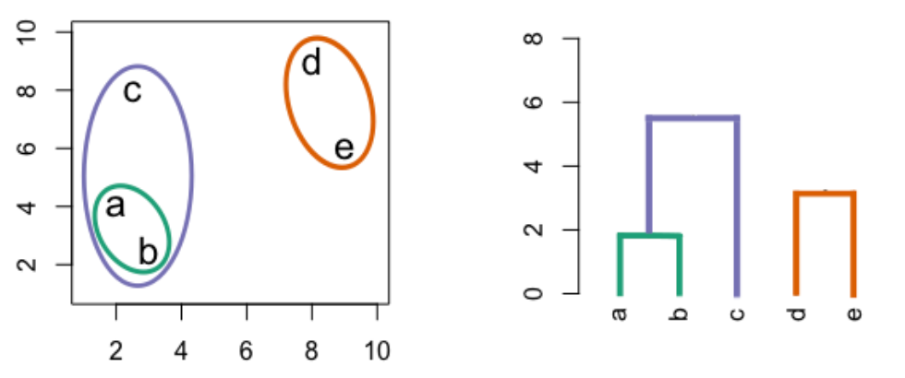
Hierarchical clustering
Slide courtesy Paul Fannon

Slide 50
Hierarchical clustering
Slide courtesy Paul Fannon

Slide 51
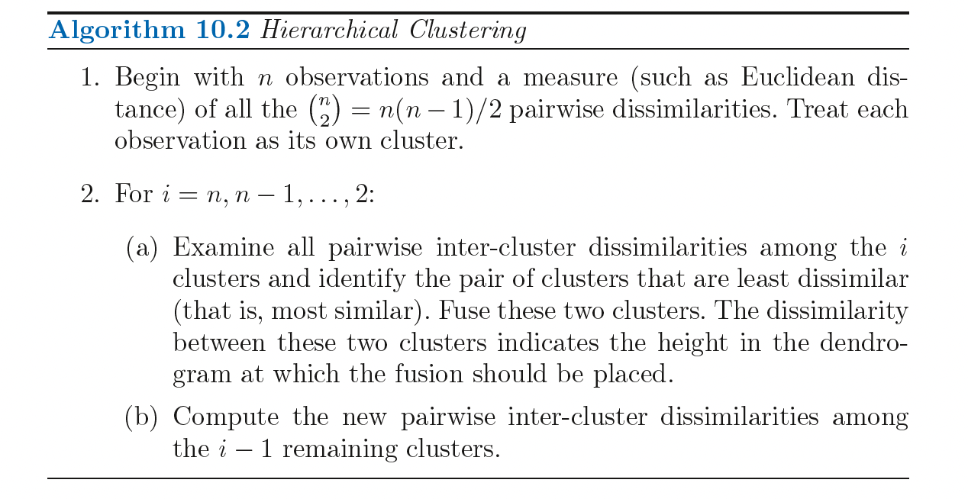
Hierarchical clustering

Slide 52
Dissimilarity measures
Euclidean distance
Correlation based distance

Slide 53
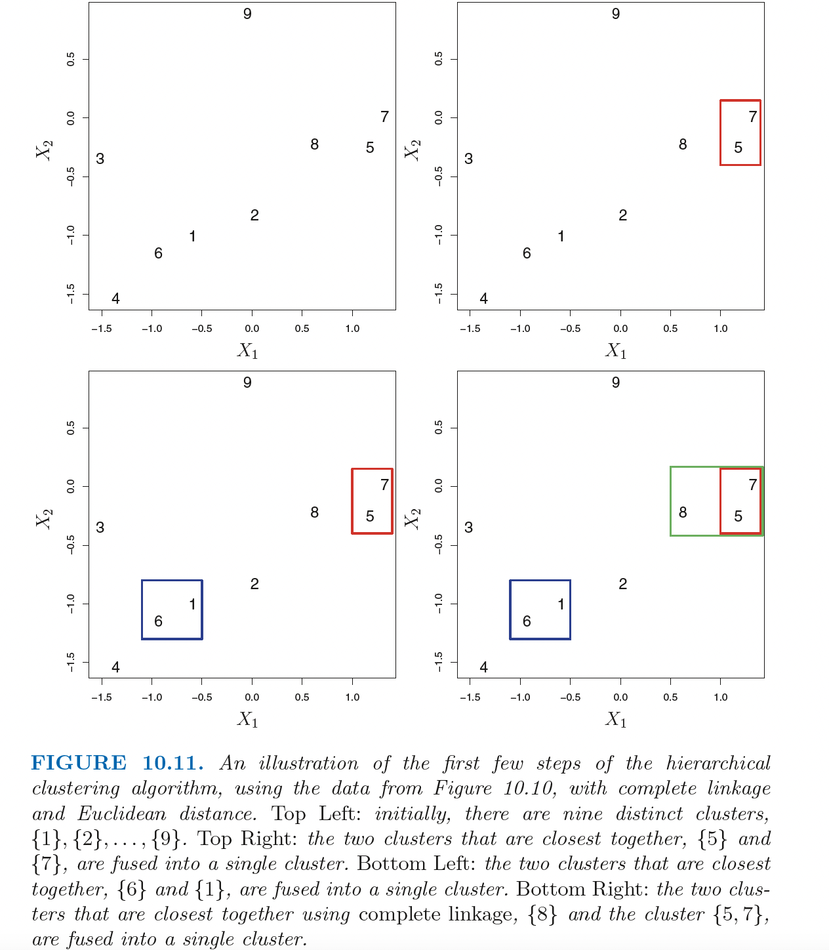
Dissimilarity measures

Slide 54
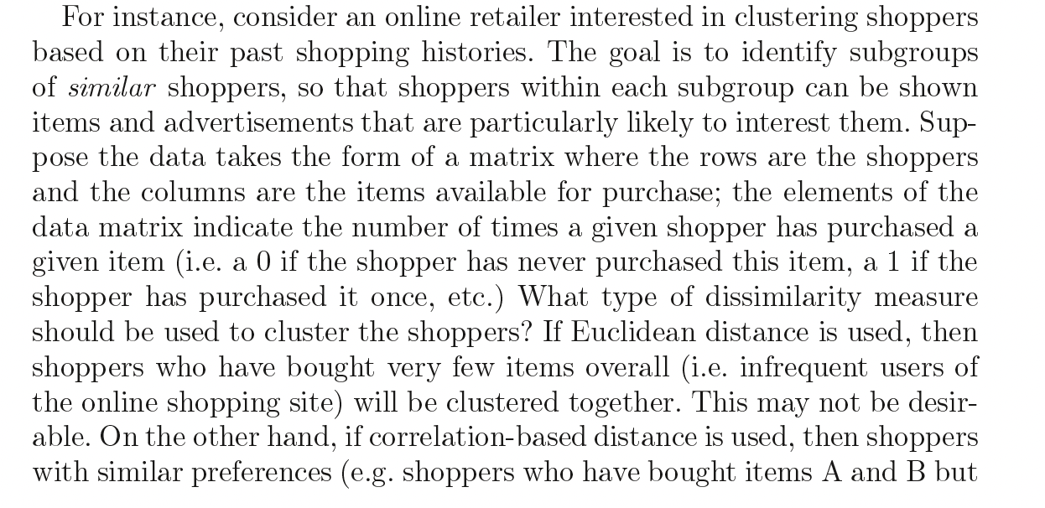
Dissimilarity measures

Slide 55
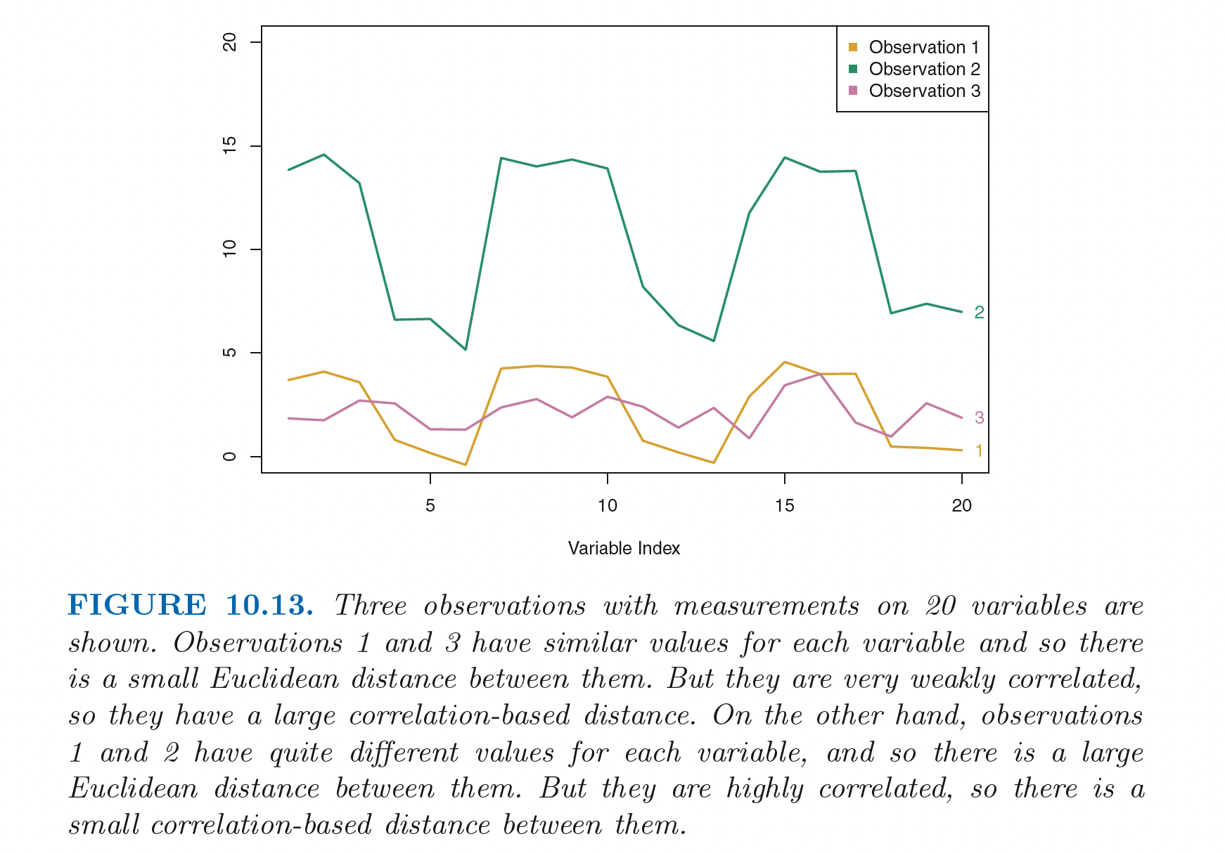
Dissimilarity measures

Slide 56
Dissimilarity measures

Slide 57
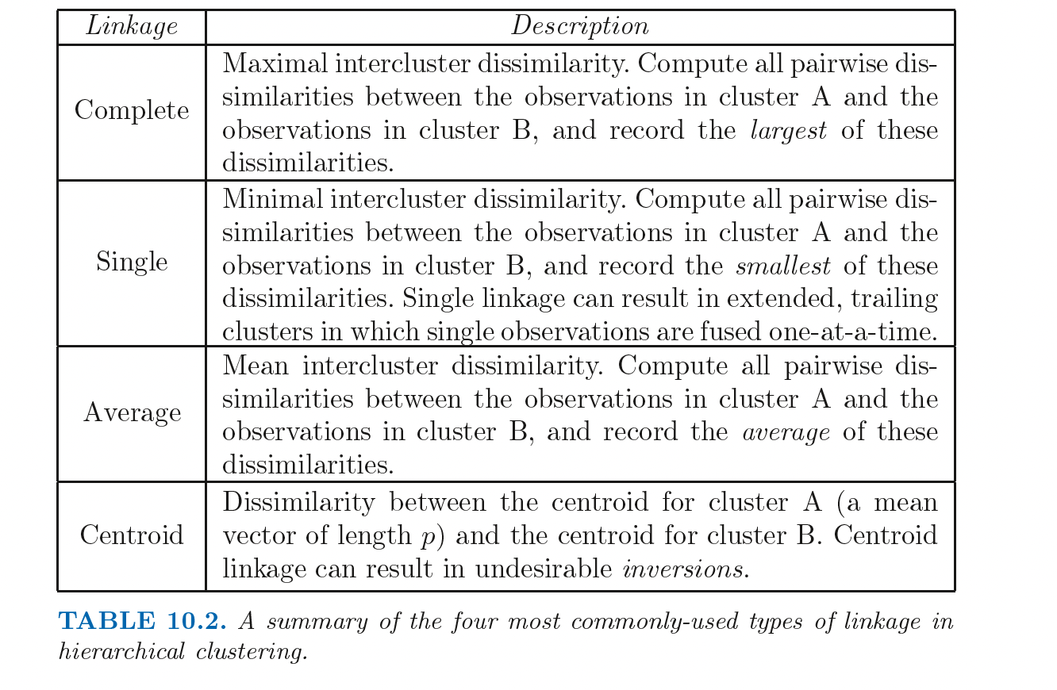
Dissimilarity measures

Slide 58
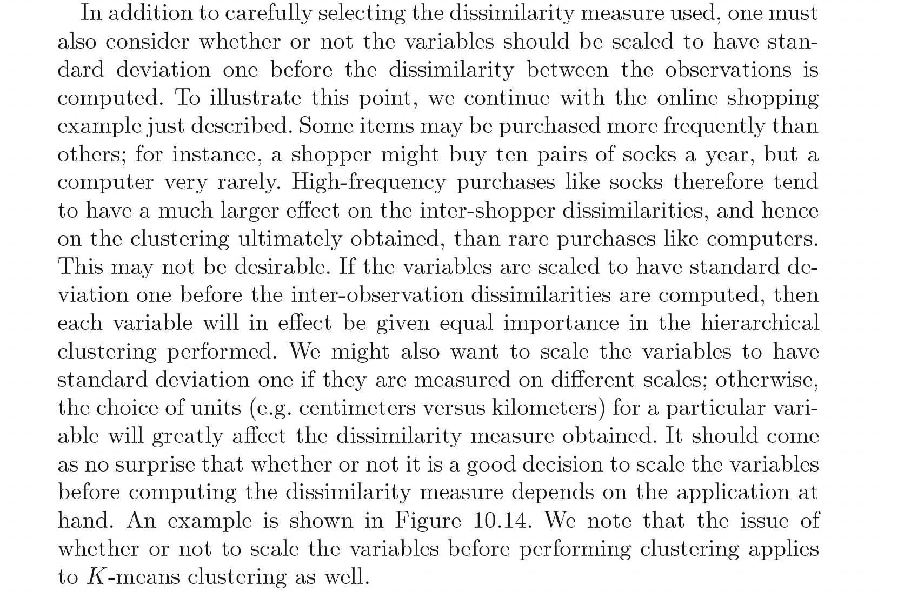
Scale variables/features

Slide 59
Comparing k means to Hierarchical
Advantage of k means over hierarchical:
Faster computationally.
Does not require choice of linkage.
Advantage of hierarchical over k means
Does not require number of groups to be known in advance.
No random seeds so more reproducible.
Does not assume spherical shape.
Slide courtesy Paul Fannon

Slide 60
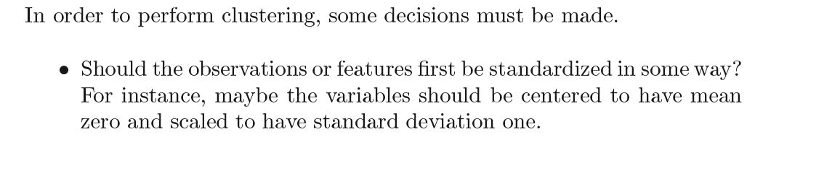
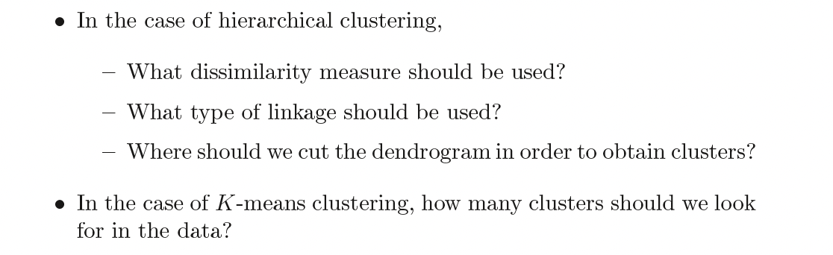
Decisions

Slide 61
Validating clusters
Validate clusters in external dataset
Hypothesis generation

Slide 62
Interactive explanations
https://mlu-explain.github.io

